Slide 1

Robotics Project
Media Engineering Technology
Made by Team 08

Slide 2
Table of contents
01
02
03
04
05
1
Robotic Arm
Scope
Methodology
Results
Conclusion & Future Work

Slide 3
1
Robotic Arm
Introduction and examples

Slide 4
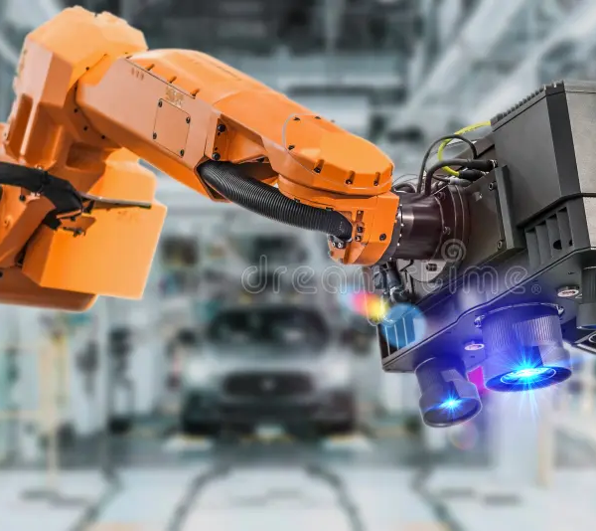
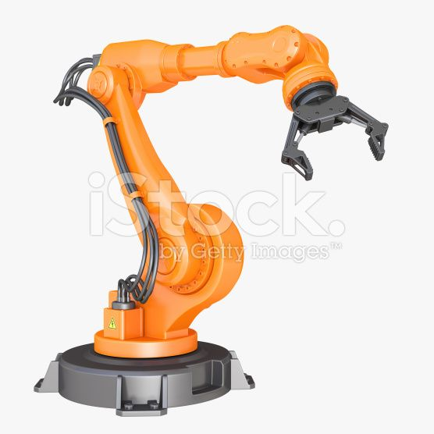
Robotic Arm:
2
2

Slide 5
2
Scope
Overview of the field

Slide 6

Our Problem:
3

Slide 7
Objectives
4
Calculate DH
parameters
Inverse Position
Forward Kinematic
Trajectories

Slide 8
3
Methodology
Techniques and applications

Slide 9
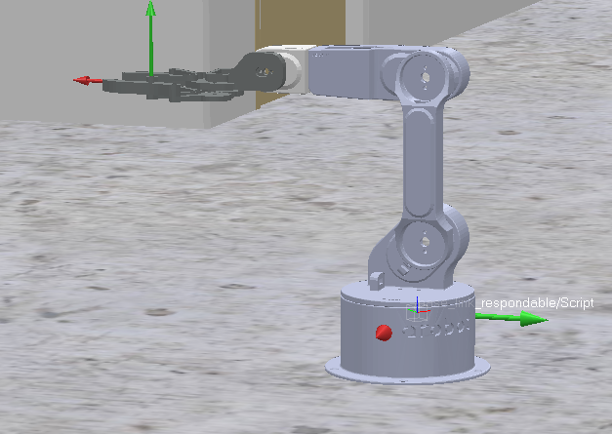
DH Parameters
5
DH_params = {
'q1_q2': {'theta': -q1, 'd': 0.0404, 'r': 0, 'alpha': 90},
'q2_q3': {'theta': -90+q2, 'd': 0.0, 'r': -0.12, 'alpha': 180},
'q3_end_effector': {'theta': 90+q3, 'd':0, 'r': 0.214, 'alpha': 0},
}

Slide 10
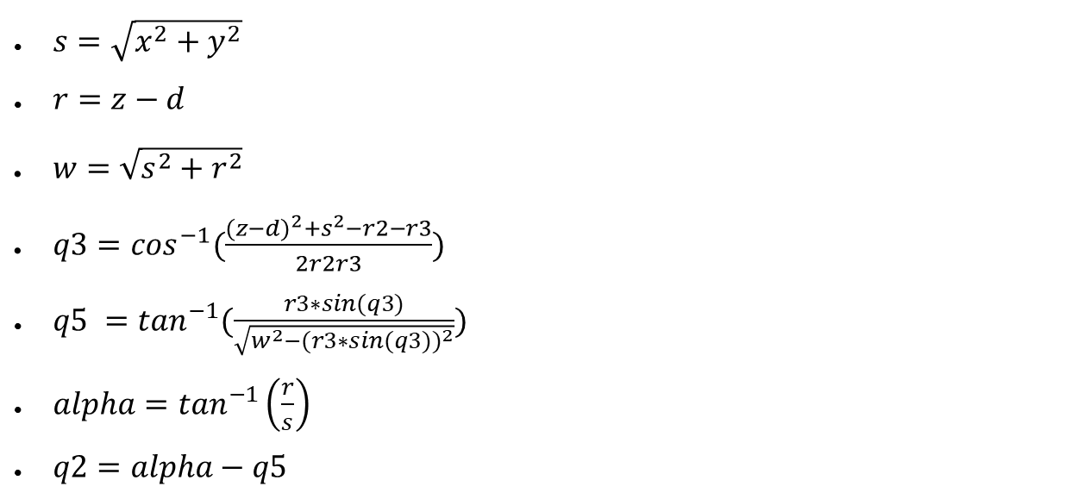
Inverse Kinematics
6
$s=\sqrt{x^{2}+y^{2}}$
$r=z−d$
${w=\sqrt{s^{2}+r^{2}}}^{}$
$q3=\cos^{−1}(\frac{{(z−d)}^{2}+s^{2}−r2−r3}{2r2r3})$
$q5 =\tan^{−1}(\frac{r3∗sin(q3)}{\sqrt{w^{2}−{(r3∗sin(q3))}^{2}}})$
$alpha=\tan^{−1}\left(\frac{r}{s}\right)$
$q2=alpha−q5$

Slide 11
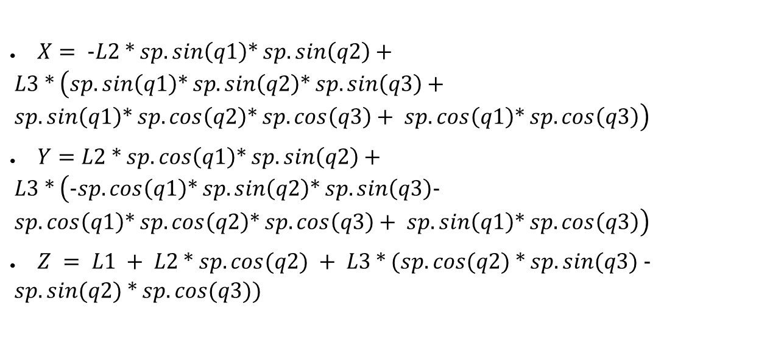
Forward Kinematics
7
$X= −L2 ∗ sp.sin\left(q1\right)∗ sp.sin\left(q2\right)+ L3 ∗ \left(sp.sin\left(q1\right)∗ sp.sin\left(q2\right)∗ sp.sin\left(q3\right)+ sp.sin\left(q1\right)∗ sp.cos\left(q2\right)∗ sp.cos\left(q3\right)+ sp.cos\left(q1\right)∗ sp.cos\left(q3\right)\right)$
$Y=L2 ∗ sp.cos\left(q1\right)∗ sp.sin\left(q2\right)+ L3 ∗ \left(−sp.cos\left(q1\right)∗ sp.sin\left(q2\right)∗ sp.sin\left(q3\right)− sp.cos\left(q1\right)∗ sp.cos\left(q2\right)∗ sp.cos\left(q3\right)+ sp.sin\left(q1\right)∗ sp.cos\left(q3\right)\right)$
$Z = L1 + L2 ∗ sp.cos(q2) + L3 ∗ (sp.cos(q2) ∗ sp.sin(q3) − sp.sin(q2) ∗ sp.cos(q3))$

Slide 12
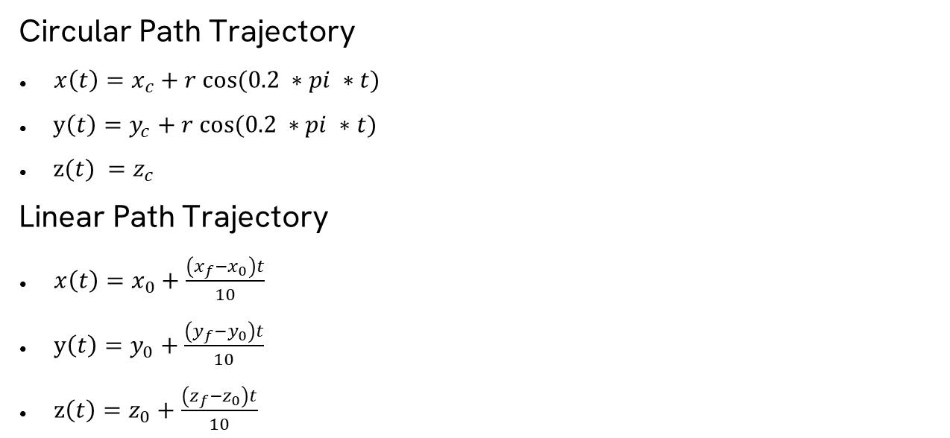
Trajectories
8
Circular Path Trajectory
$x\left(t\right)=x_{c}+r cos⁡(0.2 ∗pi ∗t)$
y$\left(t\right)=y_{c}+r cos⁡(0.2 ∗pi ∗t)$
z$(t) =z_{c}$
Linear Path Trajectory
$x\left(t\right)=x_{0}+\frac{\left(x_{f}−x_{0}\right)t}{10}$
y$\left(t\right)=y_{0}+\frac{\left(y_{f}−y_{0}\right)t}{10}$
z$\left(t\right)=z_{0}+\frac{\left(z_{f}−z_{0}\right)t}{10}$

Slide 13
4
Results
Results of my model

Slide 14
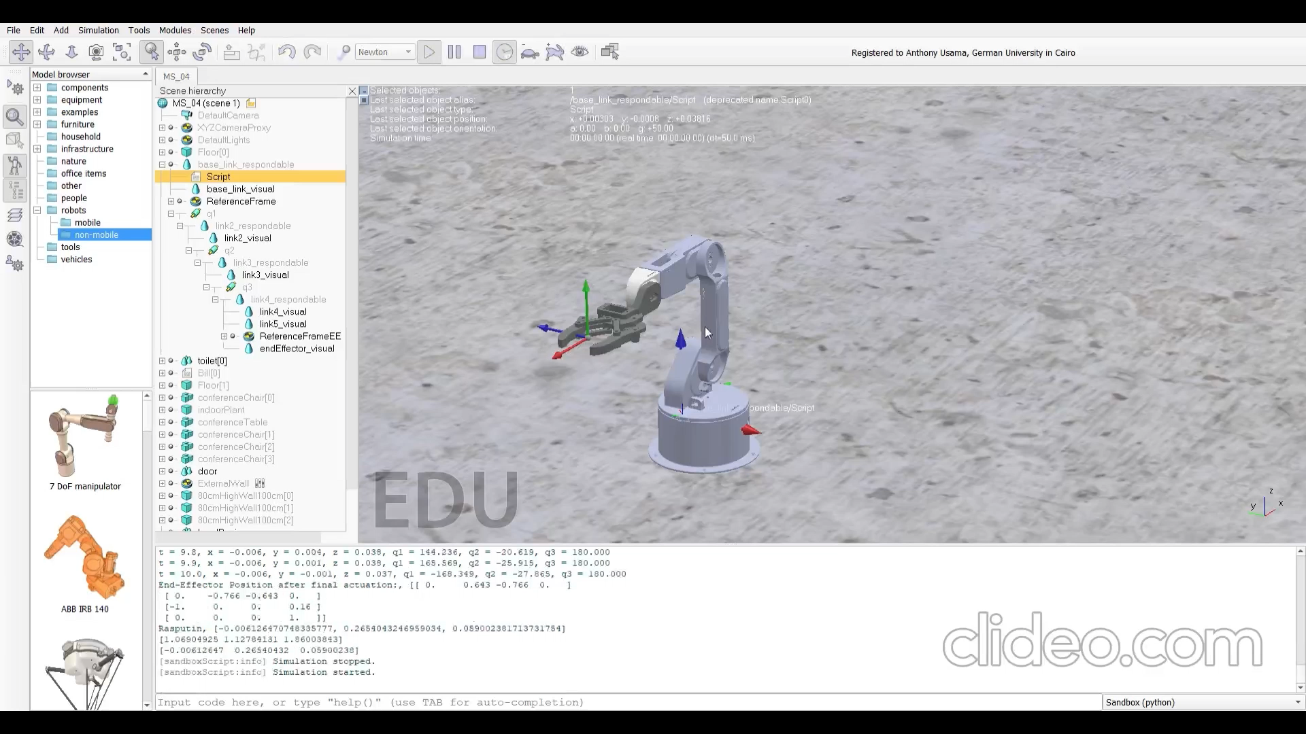
8

Slide 15
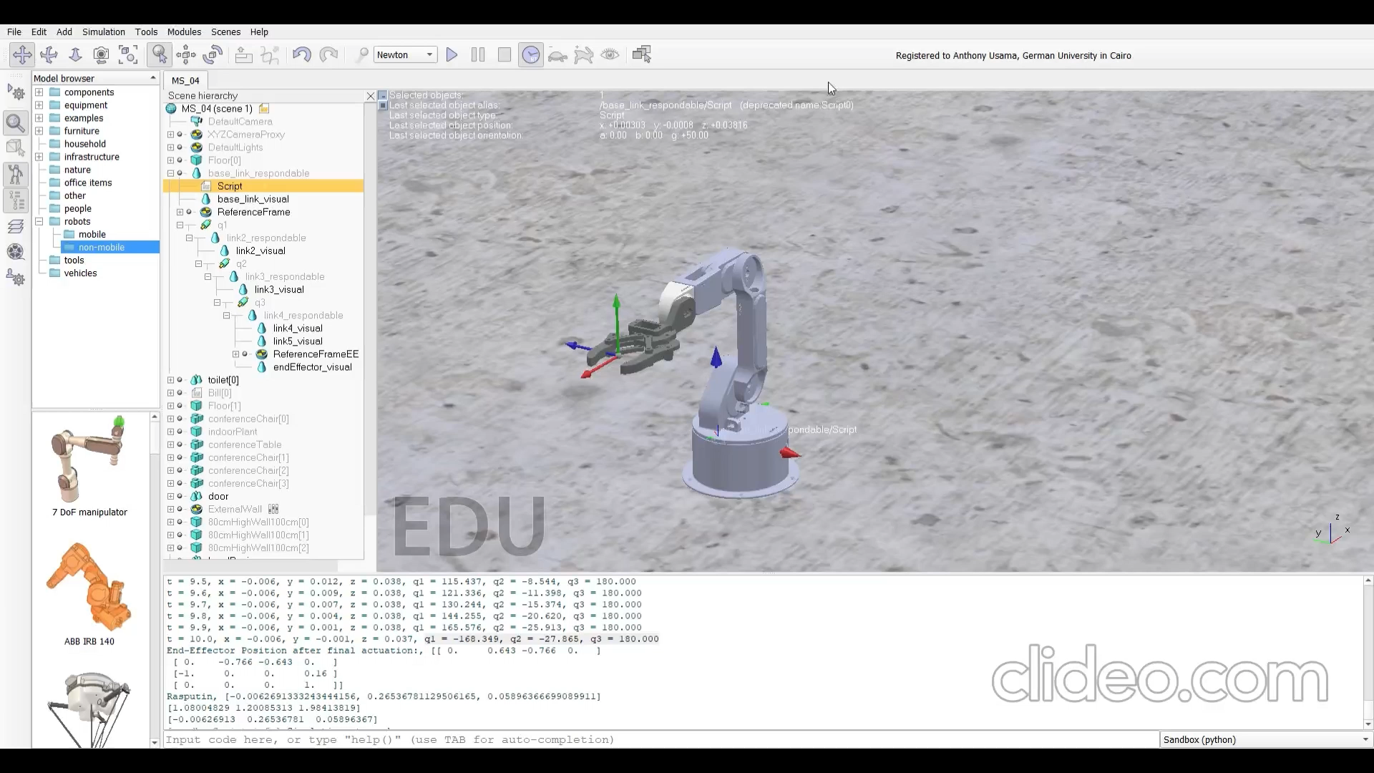
8

Slide 16
7
Conclusion
Summary and future directions

Slide 17
Conclusions
11
A model of a robotic arm is introduced and done.
Used mathematical equations to move the robot to the desired position.

Slide 18
Conclusions
12
Calculating DH parameters was achieved
Inverse Position was retrieved
Forward Position was retrieved
Trajectories was planned and executed

Slide 19
Future Work
13
Try out another editor like Unity.

Slide 20
Thanks!
Do you have any questions?

